Slide 1
Unmanned Aerial Aehicle (UAV)
Mohammed Salem Banawair 1515875
robotic hardware systems

Slide 2
History of the robot
What is considered a drone in the first place?
*is a flying robot that can be remotely controlled or fly autonomously through software-controlled flight plans in their embedded systems, working in conjunction with onboard sensors and GPS
Drones Vs Unmanned Aerial Vehicle?
*he two terms are often used interchangeably but, UAVs need to have autonomous flight capabilities, whereas drones do not. Therefore, all UAVs are drones but not vice versa.

Slide 3
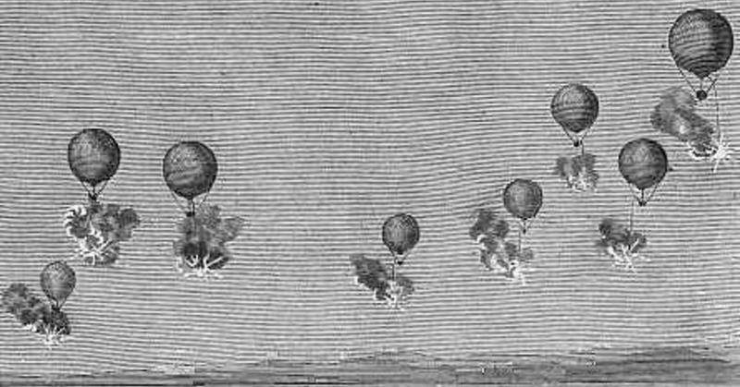
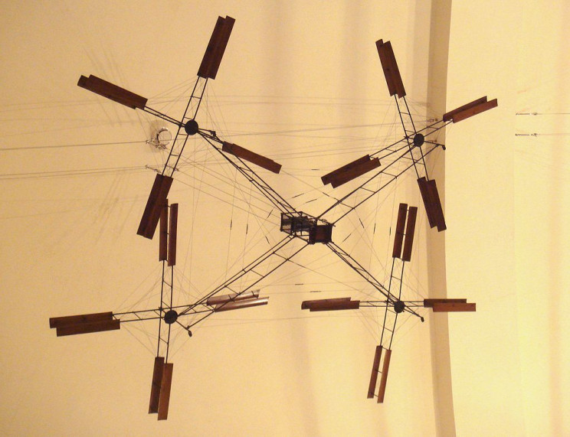
History of the robot
Early concepts
mid-1850
*The concept of drones might have been started when
Austria attacked Venice using unmanned balloons stuffed with explosives
first quadcopters appeared in the early-1900s
*it achieved the first ascent of a vertical-flight aircraft with a pilot,
it only reached a height of 0.6 meters. It was also not a free flight,
as four men were needed to steady the structure.
Which showed that the concept of a quadcopter would work for flight.

Slide 4
History of the robot
Leaps in technology
1915-1920 big leap
* the first pilotless aircraft which used a radio guidance system was developed in 1916 and was called Ruston Proctor Aerial Target
1930-1945 major leaps
* in 1935, the British developed “Queen Bee”, a radio-controlled target drone, which is also believed to have led to the use of term “drone,” for radio-controlled unmanned aircrafts.
* the he V-1 "Doodlebugs“ used a simple autopilot to control altitude and airspeed; a pair of gyroscopes controlled yaw and pitch; the azimuth was maintained using a magnetic compass; a barometric device was used to control altitude. The gyros, rudder, and elevator were controlled using pressurized air.

Slide 5
History of the robot
1990-2010 was a pivotal period for military and civilian drone development
*Mini and micro versions of UAVs were introduced in 1990, and, the famous Predator drone was introduced in 2000. This was used in Afghanistan to launch missiles and in the search of Osama Bin Laden. In the following years, a number of small-sized, fixed-wing surveillance drones such as Raven, Wasp, and Puma were developed by AeroVironment Inc.
*2006 was another pivotal year in the history of drones. This was the year that the FAA officially issued the first commercial drone permit.

Slide 6
History of the robot
2010-today might just be the "Golden Age" of drones
* Equipping drones with cameras is now commonplace in commercial photography and videography. This is the result of a merging of radio-controlled (RC) aircraft and smartphone technology.
*he rapid growth in the usage of smartphones reduced the prices of microcontrollers, accelerometers, and camera sensors, which are ideal for use in fixed-wing hobbyist aircraft. Further advances allowed a drone with 4 or more rotors to be controlled by adjusting the speed of individual rotors.
*Improving the stability of multirotor aircraft opened up new possibilities for them to be used in a number of ways.

Slide 7
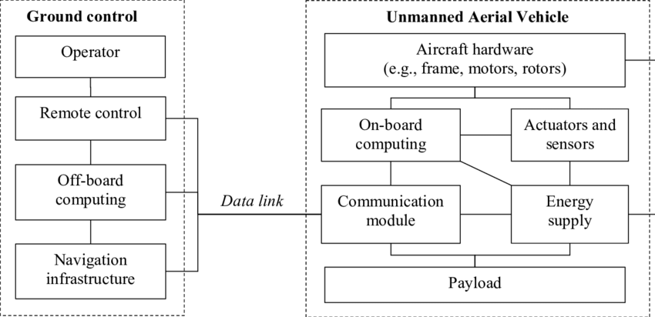
Basic System Architecture

Slide 8
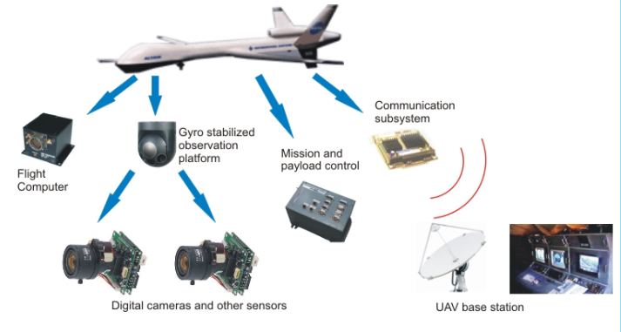
Basic System Architecture
*An UAV is a complex system composed of six main sub modules that work coordinately to obtain a highly valuable observation platform

Slide 9
Basic System Architecture
* The UAV airframe. A simple, lightweight, aerodynamically efficient and stable platform with limited space for avionics, and obviously no space for a pilot.
*The flight computer. The heart of the UAV.A computer system designed to collect aerodynamic information through a set of sensors (accelerometers, gyros, magnetometers, pressure sensors, GPS, etc.), in order to automatically direct the flight of an airplane along its flight-plan via several control surfaces present in the airframe.
*The payload. A set of sensors composed of TV cameras, infrared sensors, thermal sensors, etc. to gather information that can be partially processed on-board or transmitted to a base station for further

Slide 10
Basic System Architecture
*The mission/payload controller. A computer system onboard the UAV that has to control the operation of the sensors included in the payload. This operation should be performed according to the development of the flight-plan as well as the actual mission assigned to the UAV.
*The base station. A computer system on the ground designed to monitor the mission development and eventually operate the UAV and its payload.
*The communication infrastructure. A mixture of communication mechanisms (radio modems, sitcom, microwave links, etc.) that should guarantee the continuous link between the UAV and the base station

Slide 11
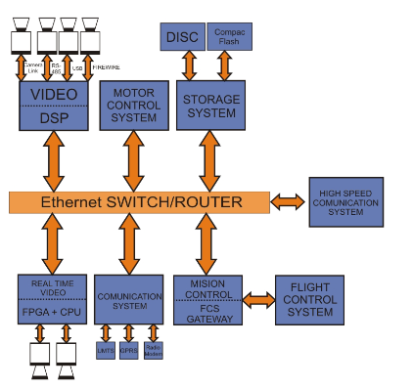
Basic System Architecture
*The hardware architecture of the proposed Mission Control Computer is built as a set of embedded microprocessors connected by a local area network (LAN)
*The high level of modularity of a LAN architecture offers extreme flexibility to select the actual type of processor to be used in each sub module. Different processors can be used according to functional requirements, and they can be scaled according to computational needs of the application.

Slide 12
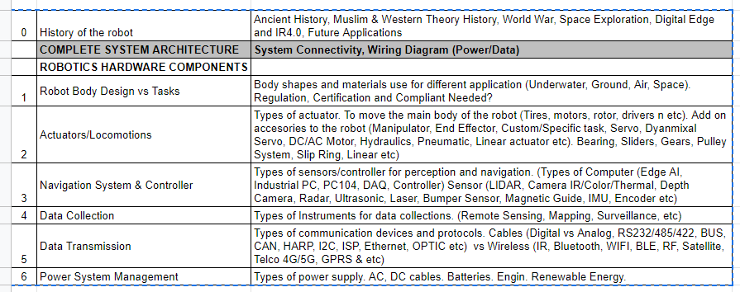

Slide 13
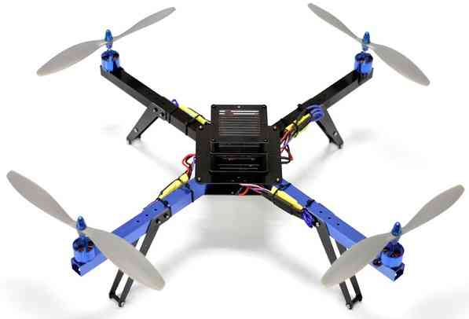
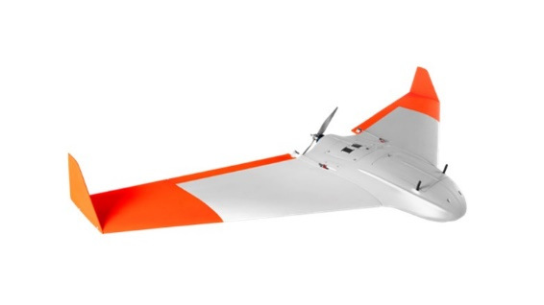
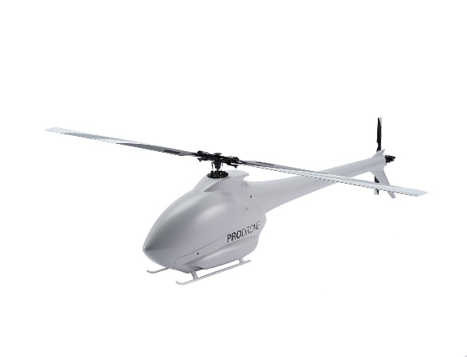
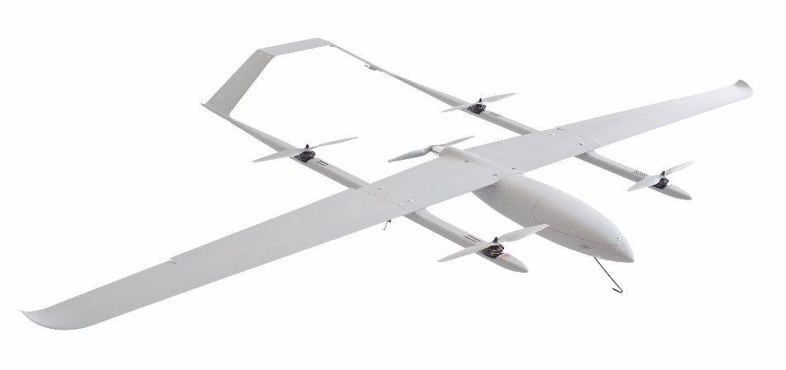
1) Robot Design Vs Task
Here’s a rundown of the four main types of drones, their uses, their strengths and weaknesses:
Multi-Rotor drone Fixed-Wing
Single-Rotor Fixed-Wing Hybrid

Slide 14
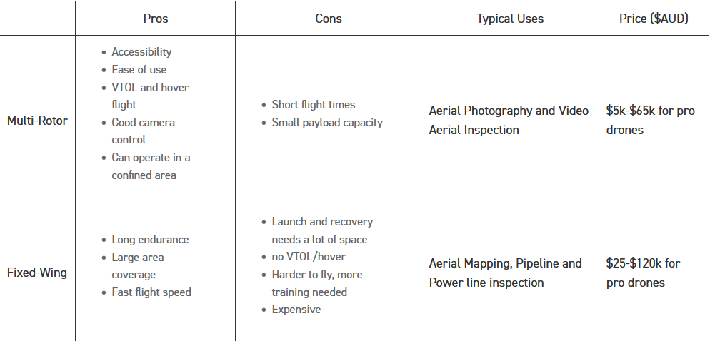
1) Robot Design Vs Task

Slide 15
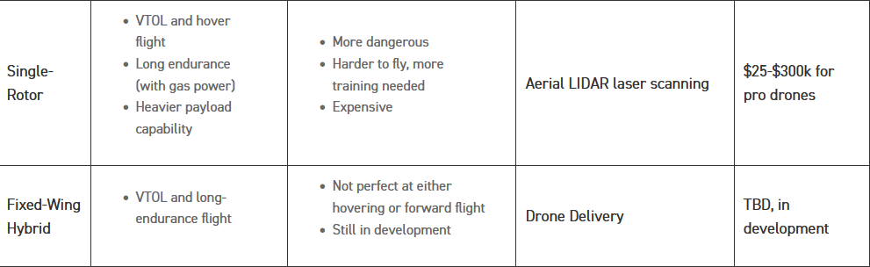
1) Robot Design Vs Task

Slide 16
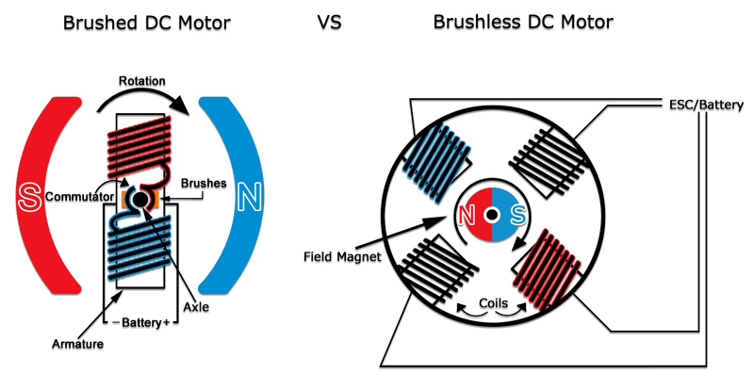
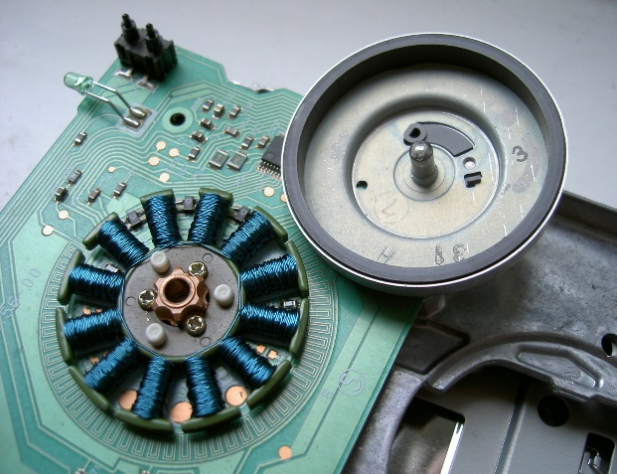
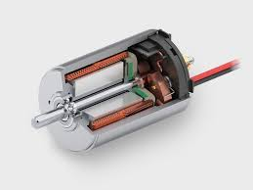
2) Actuators and Locomotion's
There is 2 basic types of motors used in drones , brushed and brushless motors.
Brushless is better in term of power and efficiency and last longer but cost more than brushed motor

Slide 17
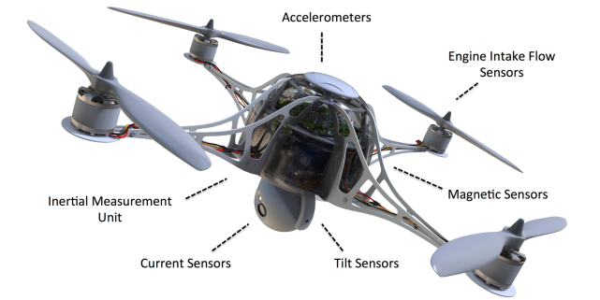
3) Navigation System & Controller
some of the types of sensor technologies that power today's drones.

Slide 18
3) Navigation System & Controller
Accelerometers
are used to determine position and orientation of the drone in flight.
*One type of technology senses the micro movement of very small structures embedded in a small integrated circuit (mechanical based sensors). indicating a change of position relative to gravity.
*Another type is senses changes in the movement of gas molecules passing over a small integrated circuit (thermal sensing) because they have no moving parts, they offer much better stability and accuracy than mechanical based sensors. Which is great is applications like filmmaking because of the stability.

Slide 19
3) Navigation System & Controller
Inertial Measurement Units
combined with GPS are critical for maintaining direction and flight paths, which ultimately indicates direction, orientation, and speed.
Tilt Sensors
combined with gyros and accelerometers, provide input to the flight-control system in order to maintain level flight
Magnetic Sensors
electronic compasses provide critical directional information to inertial navigation and guidance systems.

Slide 20
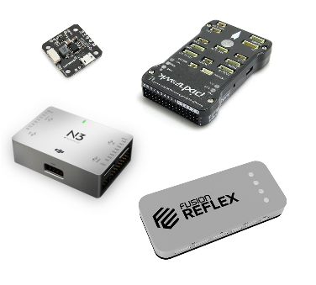
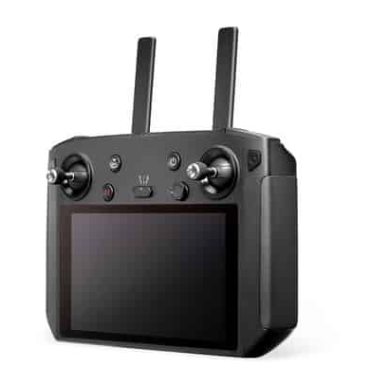
3) Navigation System & Controller
Control
A) Human operator:
A flight controller is a circuit board that manages the drone’s flight.
Put simply, the flight controller’s job is to control the power,
or RPM (Revolutions Per Minute), for each individual motor
on the drone in response to the information received from the drone controller.
When a drone pilot shifts the joystick to the right on the drone controller,
the drone flight controller is what actually makes the drone move to the right.

Slide 21
3) Navigation System & Controller
Type of Flight controllers
FC’s for hobbyists/builders – Easy to install and perfect for people that do not want to spend large amounts of money from the get-go.
Racing FC’s – Designed to be very lightweight, precise, and responsive. Most of them are in the €50,- or less range

Slide 22
3) Navigation System & Controller
Type of Flight controllers
FC’s for filming – Although mostly bought included in a drone with a camera, these flight controllers are more focused on creating fluent shots and accessible handling for a pilot.
Commercial FC’s These are for the most advanced drones, capable of safe flying and transporting high-value cargo. The biggest players in this field are DJI and Pixhawk

Slide 23
3) Navigation System & Controller
Control
B) Autonomous
* Autonomous drones capture image and video signals from around them through high-quality image sensors, convert them to digital signals using computer vision and create mappings using GPS.
* by utilizing methods and algorithms of artificial intelligence it can create alternative paths of movement and continue moving and performing tasks that they’re designed for.

Slide 24
4) Data Collections
A) Information received via sensors
A drone can have many types of sensors to collect information, such as changes in speed, distance, temperature, wind, chemical signals, light, sound, and can even identify the presence of magnetic objects.
B) Images
A farmer can use drones with thermal, infrared, or HD imaging capabilities to capture clear images of his crops.
filmmakers can use drones to shoot stunning images for filmography.
Public institutions find it useful for planning a city’s infrastructure.
And to study the behaviour of wildlife and marine animals.

Slide 25
4) Data Collections
C) Voice and video communications
emergency services, and search and rescue missions
D) Location and navigation
Drones equipped with GPS trackers and radar are used for navigation and location-sensing during mapping, surveillance, geospatial exploration, etc.

Slide 26
5) Data Transmission
Data transmission radio is a main tool for communication between aircraft and ground stations.
Computers give the aircraft tasks, real-time flight altitude, speed, and many other data will be transmitted through it, so that we can monitor the situation of the aircraft from time to time and modify the aircraft's course at any time.

Slide 27
5) Data Transmission
Wireless Technologies for Video Transmission
can be used for fairly short distances. The range of a Wi-Fi signal, can range from 300 to 2000 meters
However, the range of the wireless video link is limited by a number of factors. The path loss itself will diminish the signal when distance increases, and obstacles in the line of sight can give additional attenuation.

Slide 28
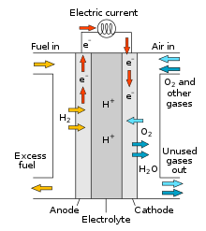
6)Power System Management
There are many different power sources available on the market, such as
batteries, solar power, FCs, combustion engines.
With each have it advantages and disadvantages.
One of the interesting renewable sources is Hydrogen Fuel Cell:
produce electricity by combining hydrogen and oxygen atoms

Slide 29
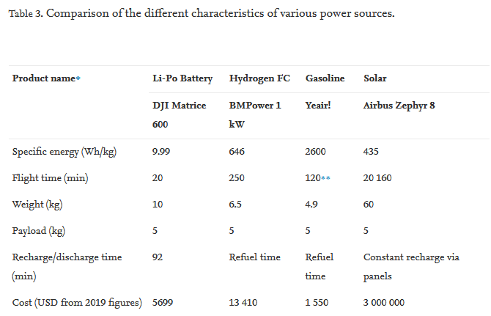
6)Power System Management

Slide 30
6)Power System Management
Sensors that help in controlling power consumption
Engine Intake Flow Sensors
Flow sensors can be used to effectively monitor air flow into small gas engines used to power some drone varieties. These help the engine CPU determine the proper fuel-to-air ratio at a specified engine speed.
Current Sensors
can be used to monitor and optimize power drain, safe charging of internal batteries, and detect fault conditions with motors or other areas of the system.

Slide 31
LIST OF UAV Company (Service / Manufacture/ Components) Locally
*AERODYNE
*POLADRONE
*DEFTECH
*Vortex Edge (is the first Malaysian developer of unmanned systems, including Unmanned Aerial Vehicles as well as Unmanned Ground Vehicles (UGV) with indigenous Flight Controller (Autopilot).
*Sami ( Saudi Arabian Military industries) (plans to produce Saudi-made drone )

Slide 32
References
A Brief History of Drones: The Remote Controlled Unmanned Aerial Vehicles (UAVs)
https://interestingengineering.com/a-brief-history-of-drones-the-remote-controlled-unmanned-aerial-vehicles-uavs
A HARDWARE/SOFTWARE ARCHITECTURE FOR UAV PAYLOAD AND MISSION CONTROL
https://upcommons.upc.edu/bitstream/handle/2117/8697/25_digital%20_avionics_pastor.pdf

Slide 33
References
Drone Types: Multi-Rotor vs Fixed-Wing vs Single Rotor vs Hybrid VTOL
https://www.auav.com.au/articles/drone-types/
Flight Controllers explained for everyone.
https://fusion.engineering/flight-controllers-explained-for-everyone/
Drone applications: The use of drones for data collection
https://mirragin.com.au/drone-applications-the-use-of-drones-for-data-collection/

